Slide 1


Hackathon 2023

Slide 2
Team Name

Slide 3
Team Introductions and Pictures

Slide 4
Customer challenge or Problem being solved?

Slide 5
Source Code
If applicable provide a link to your source code (github or other)
Provide as much information as possible in your source code so that others may use your project in the future (ex, readme file and installation instructions)

Slide 6
Architecture Diagram
Simple diagram of your architecture for a better understanding of your solution

Slide 7
Tools & Technologies Used
(e.g. Angular, AWS, K8, Swagger, etc)
Feel free to use cut and paste icons on this page

Slide 8
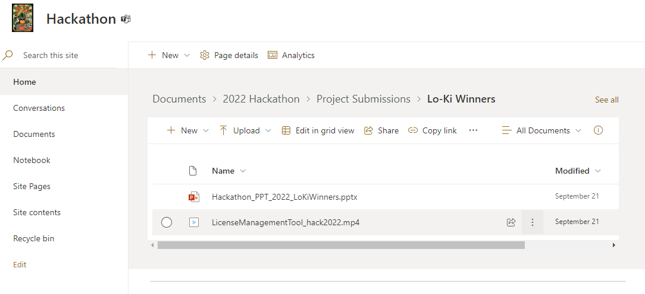
Documentation
Create your project submission folder here with your project name
Use this folder to upload your documents & video submission
Example:

Slide 9
Video Submission
Video Rules
Video must be uploaded to your documentation folder
Video must be in HD (1080) or 4k and shot horizontally
Video must be no longer than 2 – 6 mins in length and in mp4 format
Video naming format (Hack Name_hack2022)
Video Outline and Timeline (6 mins max)
Introduce the team- <1 min
Introduce the problem/challenge that you are solving- <1 min
Demonstrate your solution and tell us how it solves the problem/challenge- <8 min
Other considerations
Sell your idea! The idea is what holds value.
Why should we invest in your solution?
Your video submission will be judged on
• Scalability – Can your hack accommodate expansion without compromising efficiency?
• Business Value – Does your hack align with what our customers are asking for?
• Innovation – Did you find a new or unique way to use technology to solve an existing problem?
• Polish – Was the final submission package professional, organized, and well presented?
• Wow Factor – Did your hack make a strong, positive impression on the judges?

Slide 10
GOOD LUCK!

